Slide 1

CT 216 PROJECT
LDPC CODE for 5g NR
LAB 5 GROUP 26
Professor : Yash Vasavada
Mentor : Dhriti Goenka

Slide 2
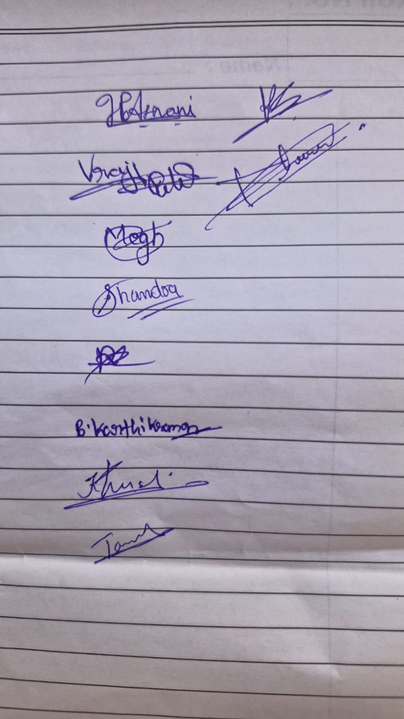
TEAM MEMBERS
202301282 HRIDAY ASNANI
202301401 DHRUVI JOBANPUTRA
202301402 MEGH DINESHBHAI BAVARVA
202301403 SHOBHITCHANDRA CHAUDHARI
202301404 RAMANI DARSHIT
202301405 TANISH TANAWALA
202301406 KHUSHI PANDYA
202301407 KARTHIK RAMAN BALAMURUGAN
202301408 VRAJ PATEL
202301409 KIRTAN CHAUHAN

Slide 3

HONOUR CODE
We declare that
→ The work that we are presenting is our own work.
→ We have not copied the work (the code, the results, etc.) that someone else
has done.
→ Concepts, understanding and insights we will be describing are our own.
→ We make this pledge truthfully. We know that violation of this solemn pledge
can carry grave consequences.

Slide 4
INTRODUCTION ABOUT LDPC
Low-Density Parity-Check (LDPC) codes are a type of error-correcting code used in digital communication systems to detect and fix errors that occur during data transmission, especially due to noise in the communication channel.
These codes are especially important because they can help achieve data transmission speeds very close to the maximum limit defined by Shannon’s theory known as the Shannon Channel Capacity.
Today, LDPC codes are used in many modern communication systems, including 5G wireless networks, due to their excellent error correction performance and efficiency.

Slide 5
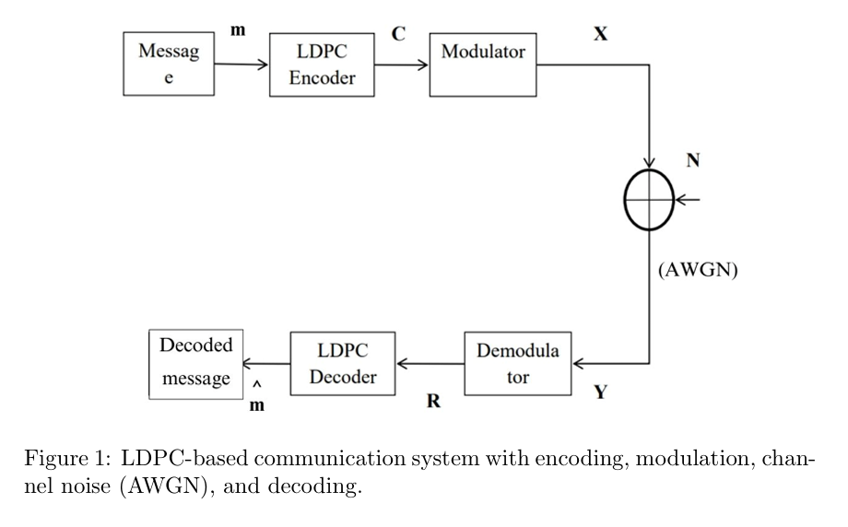
SYSTEM MODEL FOR LDPC NR

Slide 6

5G NRBase Graph Matrix and Protograph Construction

Slide 7
An LDPC Code is a type of linear block code with a sparse parity check matrix. ( The number of 1s in the matrix is much less than the total number of entries).
Let H be the parity-check matrix of size (n−k)×n,
where:– n: Total number of bits in the codeword
k: Number of message bits.

Slide 8
LDPC codes used in standards are commonly based on protograph construction.
A base graph or base matrix is used for different code rates. These base graphs are expanded using right-shift permutation matrices to form the final LDPC matrix.
The construction is optimized for performance vs decoding complexity.
In 5G New Radio (5G-NR):–
-->Two base graphs are used for different scenarios.
-->Puncturing are applied to support various code rates and block sizes.

Slide 9
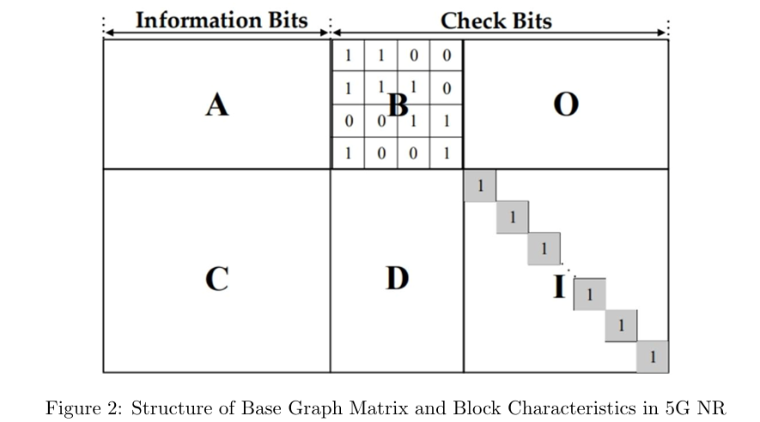
Base Graph Matrix
Let's take two non-binary base matrices:
BG1: 46 x 68
BG2: 42 x 52
Base Matrix is a proper Block Like Structure
Characteristics of Block
A: High dense part
B: Double diagonal structure
O: Zero matrix
C: Low dense part
D: Low dense part
I: Identity matrix
For BG1,
A: 4 x 22, B: 4 x 4, O: 4 x 42,
C: 42 x 22, D: 42 x 4, I: 42 x 42
For BG2,
A: 4 x 10, B: 4 x 4, O: 4 x 38,
C: 38 x 10, D: 38 x 4, I: 38 x 38

Slide 10
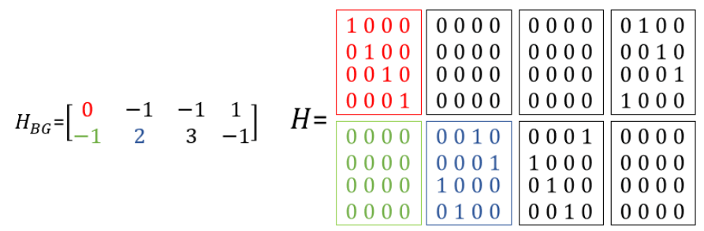
These base matrices serve as compact templates for constructing large parity-check matrices using a method called lifting or expansion.
Each entry in the base graph can take a value between −1 and Zc − 1, where Zc is known as the expansion factor (or lifting size).
Expansion Factor(Z): 4

Slide 11
encoding

Slide 12
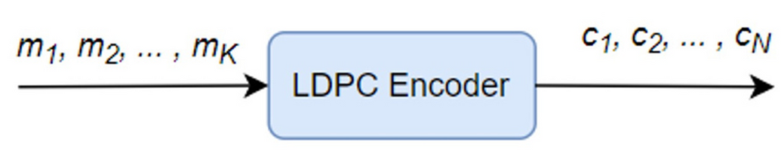
Code rate (r) = k/n
Let:
m be the message vector of size (k × 1)
p be the parity vector of size ((n − k) × 1)
c be the codeword vector of size (n × 1)
To compute the parity bits p, we use the double diagonal structure from the base graph, which is a pattern within the H matrix. This structure simplifies the calculation of parity bits and helps construct the complete codeword.

Slide 13
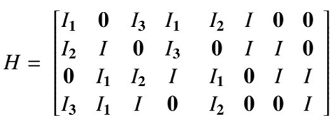
To understand how to calculate the parity bits, let’s take an example.
Suppose the message vector is:
m= [m1 m2 m3 m4]
And the parity vector is:
p = [p1 p2 p3 p4]
Then the complete codeword becomes:
c = [m1 m2 m3 m4 p1 p2 p3 p4]

Slide 14
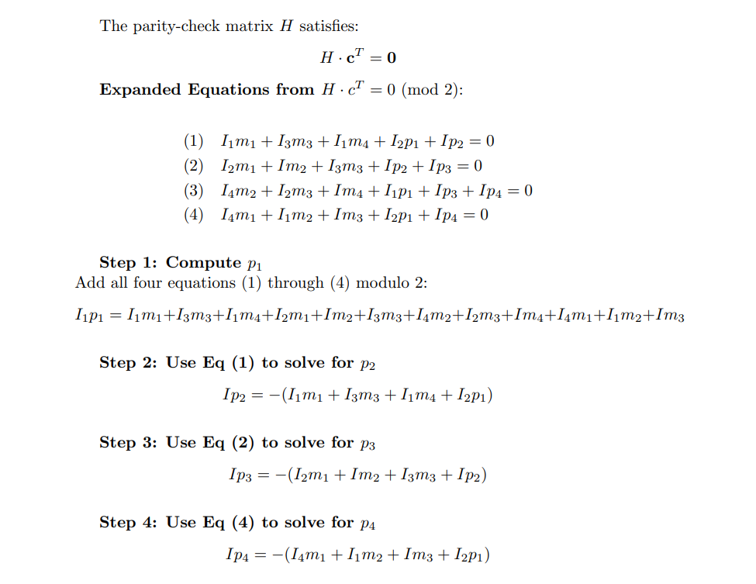

Slide 15
This method can be used with the 5G NR base graph.
For the first 4 rows, a double-diagonal pattern can be used to calculate parity bits p1, p2, p3, and p4. Then, the remaining parity bits (pi for i > 4) can be calculated from row i.
After all parity bits are found, the full codeword can be formed. In 5G NR, the first two blocks of message bits in the base graph are not sent — they are always left out (punctured) to improve performance.

Slide 16
Coderate matching

Slide 17
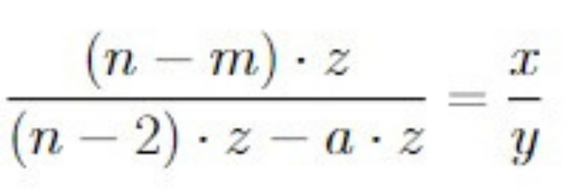
Rate matching is an essential method used with LDPC codes to tailor the code rate according
to the desired transmission rate of a communication system.
Assume we start with a base matrix of dimensions m×n and apply an expansion factor z.
This results in a codeword length of n⋅z.
Typically, the first 2z bits of the n⋅z total bits are punctured, leaving us
with (n−2)⋅z bits to work with.
Let’s say we want to achieve a code rate of x/y and now to do this assume we are punturing (a*z) bits out of the (n-2)*z bits left.

Slide 18
So here the number of message bits is (n-m)*z bits and from the equation above we can calculate the number of parity bits required.
Using this information, we can determine the dimensions of the parity-check matrix H:
Number of rows = Number of parity bits (from the equation above)
Number of columns = Calculated number of columns from the equation + 2 (to account for the initially punctured bits)

Slide 19
Lets take an example
If we have a base matrix of size 46 x 68 , we want to achieve a code rate of ⅔
So , here we can find that n = 68 , m = 46 , x = 2 , y =3
So , now substituting this in the given equation .
we can find that the value of a = 33.
we can find that the number of transmitted bits = 66z - 33z as we know if a > 0 we need to remove parity bits.
In this 33z bits , we can find that 20z bits are information bits and 13z bits are parity bits
From this , we can see the number of rows in the B matrix is 13 rows
and the number of columns in the B matrix is 33+2 = 35
So we use 13 x 35 entries from the B matrix for code rate 2/3

Slide 20
modulation and awgn

Slide 21
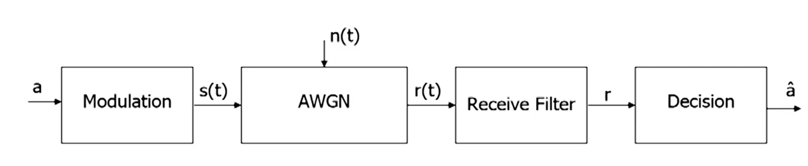
Modulation over AWGN channel :
a : Bits to be transmitted
â : Receiver’s estimated value of transmitted bit
s(t) : Waveform transmitted into the channel
n(t) : White Gaussian Noise
r(t) = s(t) + n(t) : Waveform received after addition of noise
r : Information about waveform after filtering at the receiver

Slide 22
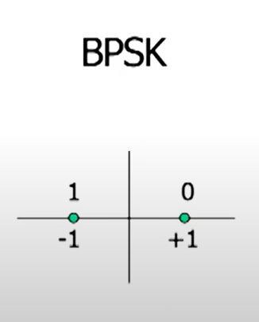
BPSK (Binary Phase Shift Keying)
• In BPSK (Binary Phase Shift Keying), encoded bits are transformed into BPSK symbols before transmission. This can be achieved by representing the bits (ones and zeros) by shifting the phase of the carrier wave (codeword bits).
• The encoded codeword bit is mapped to a BPSK symbol using the mapping, s = 1 − 2c, where s represents the BPSK symbol and c represents the codeword bit.

Slide 23
Signal-to-Noise Ratio (SNR):
SNR = Signal power / Noise power
SNR (in dB) = 10 log₁₀(Signal power / Noise power)
Signal Energy, Es​ for BPSK
Mean of square of symbols = [(−1)2+(+1)2]/2=1
Noise Power = σ2
SNR = 1/σ2

Slide 24
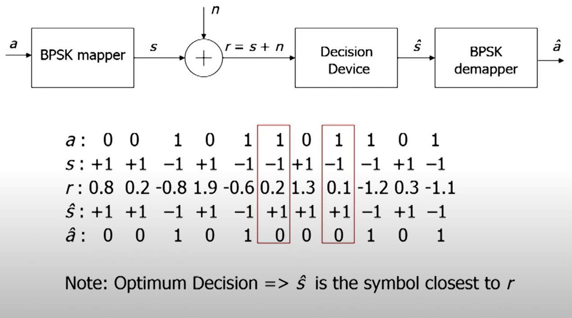

Slide 25
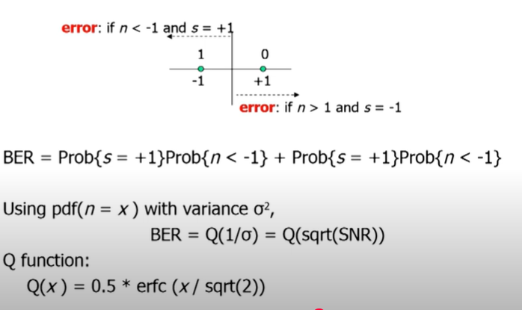
BIT ERROR RATE
Bit-Error Rate (BER):
Probability { a does not equal â }
Estimating BER:
Transmit N bits
(say N = 10000000...)
Find number of errors nₑ
(must be at least 100)
BER = nₑ / N
Here , BER = prob{s = +1}prob{n<-1} + prob{s = -1}prob{n>1}

Slide 26
DECODING

Slide 27
SOFT decision DEcoding

Slide 28
MIN-sum algorithm
ROW OPERATION
Let’s say a row has several entries (excluding zeros).
Min1 = the smallest absolute value among all nonzero entries in that row.
Min2 = the second smallest absolute value (i.e., next higher than Min1).
Then:
Set the magnitude of all other entries (not the min1.) in that row to Min1.
Set the magnitude of the minimum value entry to Min2.
New Sign = (Old Sign) *(Row Parity of Signs).

Slide 29
MIN-sum algorithm
coluMN Operation
COMPUTE TOTAL SUM FOR VARIABLE NODE J:
SUMJ=RJ+∑LI,J
where rj =received LLR , Qi,j=message from check node i to variable node j
Update Message to Each Check Node iii:
mj→i=Sumj−qi,jm (excludes its own contribution)
Estimated Bit Value cj (after iteration):
cj=sign(rj+∑qi,j)
If cj<0 decoded bit = 1
IF CJ≥0 DECODED BIT = 0

Slide 30
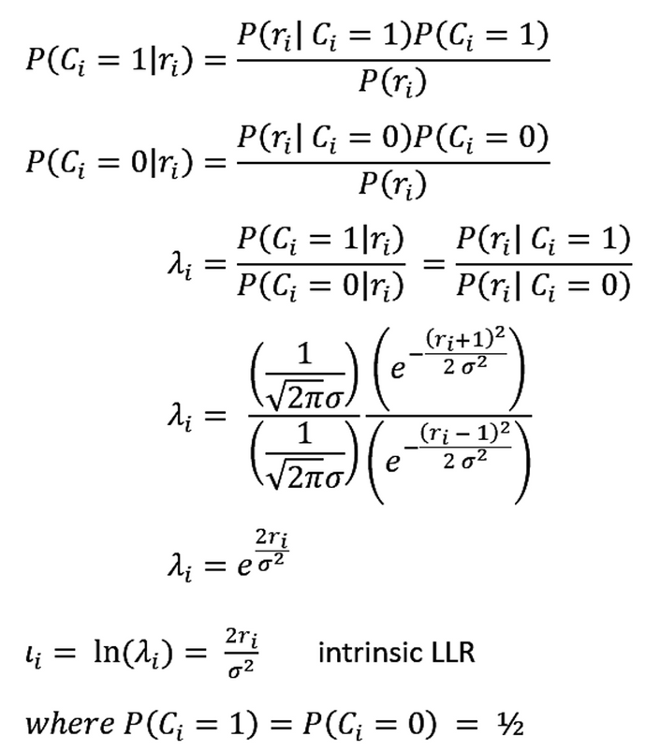
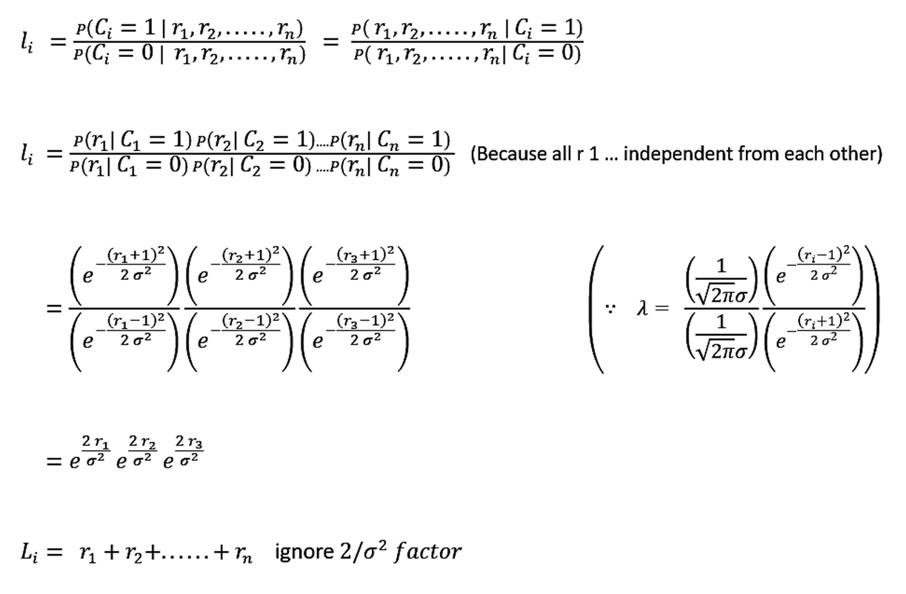
MIN-sum algorithm
•Log likelihood ratio
•For (n) Repetition

Slide 31
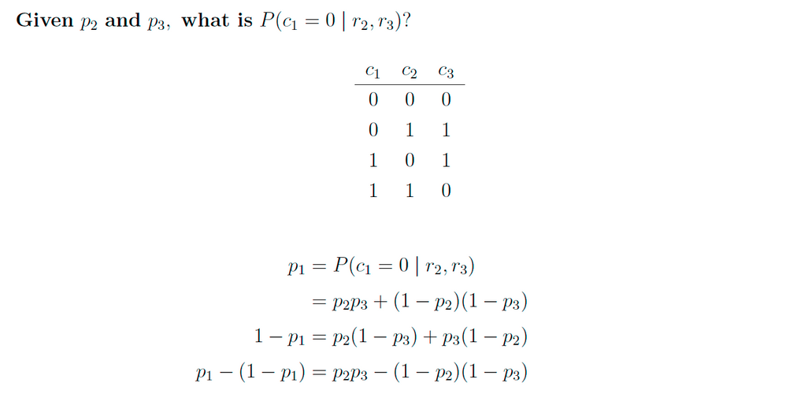
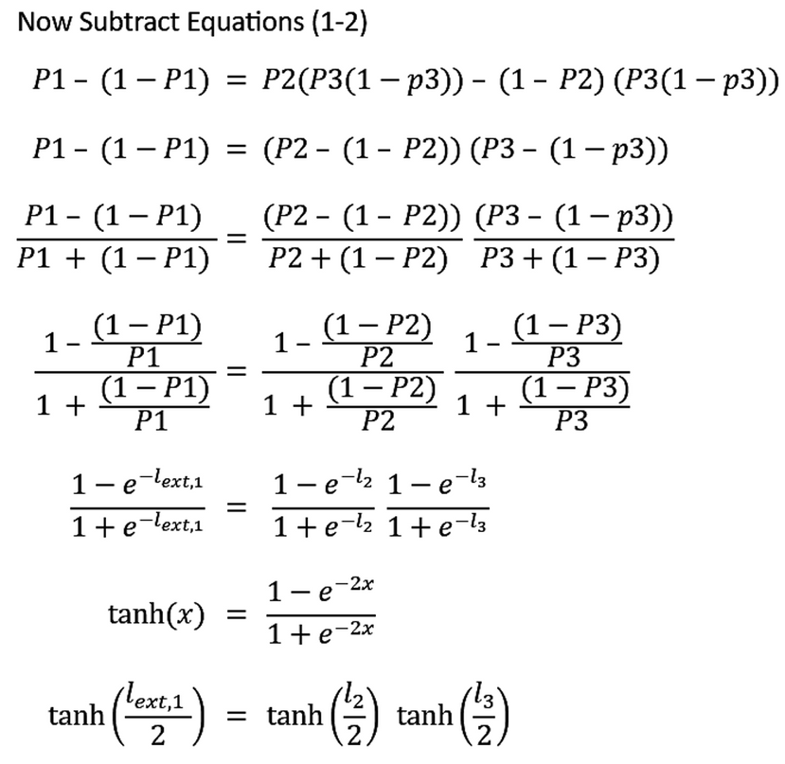
MIN-sum algorithm
(n,n-1) SPC CODE

Slide 32
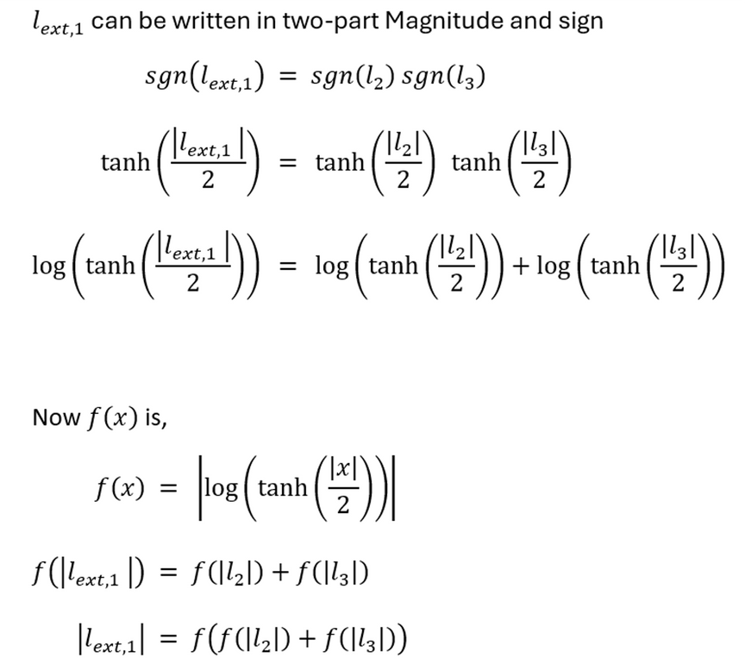
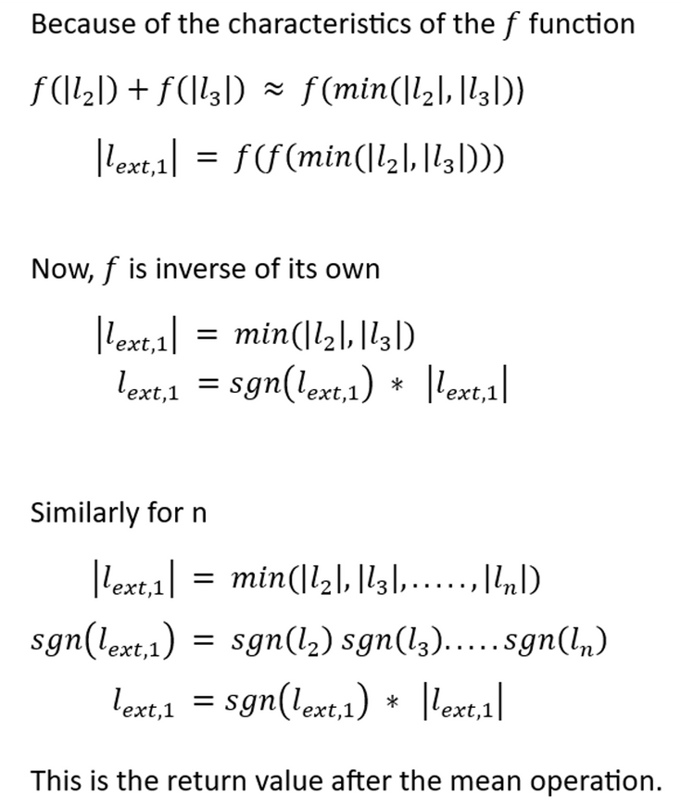
MIN-sum algorithm

Slide 33
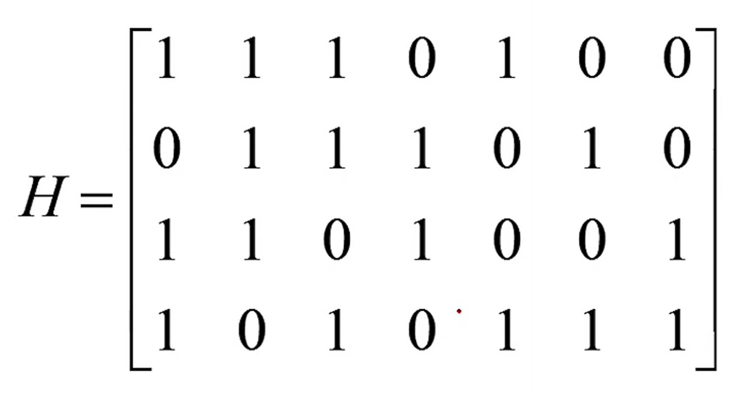
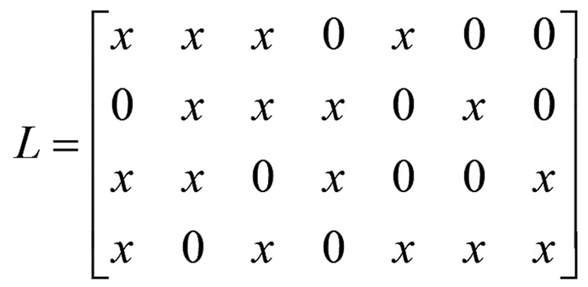
Parity Check Matrix
Storage Matrix

Slide 34
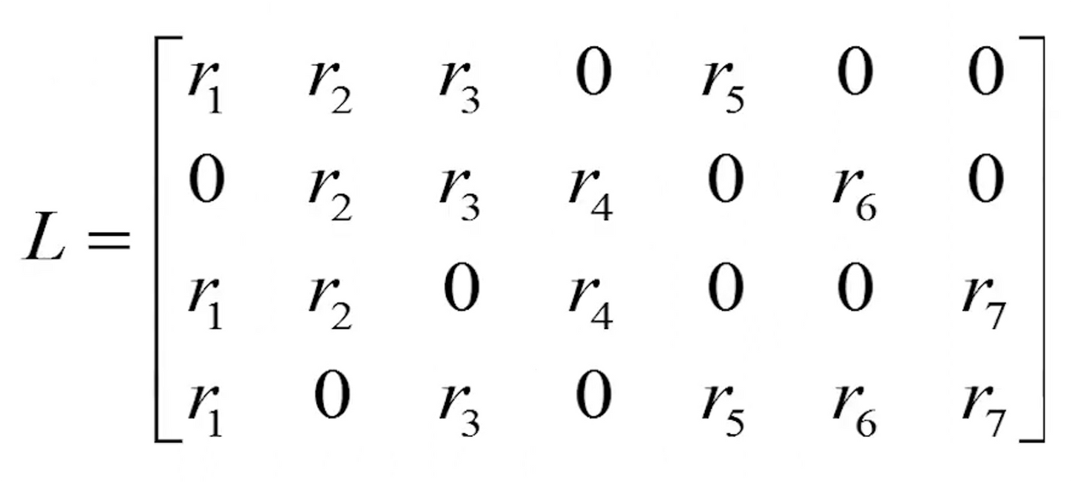
In first iteration every VN sends values to each CN

Slide 35
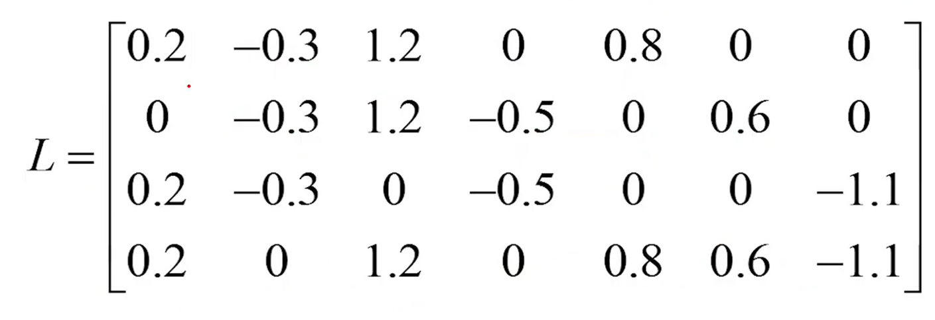
Example
• Let us visualize this algorithm through an example calculation as follows :

Slide 36
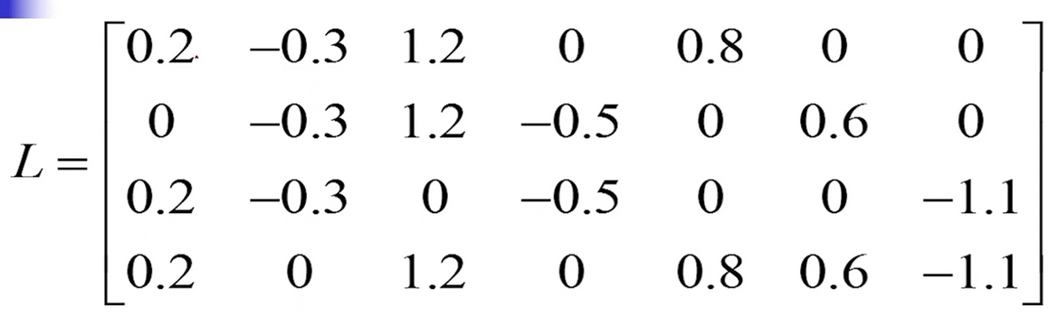


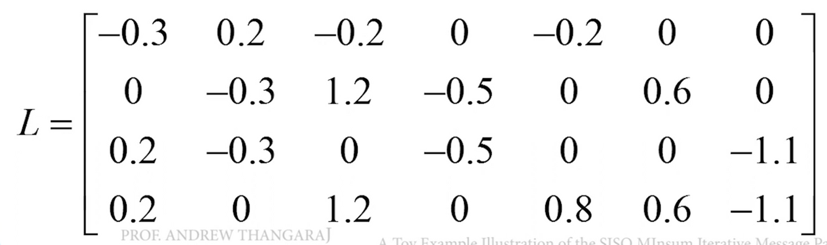
• Row Operations are performed on the matrix : -
The sign is determined by the no. of (-)ve values in the previous matrix. Odd no. of (-)ve values results in flipping of sign in the next operation, o.w. sign remains same.
On Row - 1
All elements are replaced with the lowest absolute value (Min-1) except itself. The lowest one is replaced with the 2nd smallest (Min-2).

Slide 37
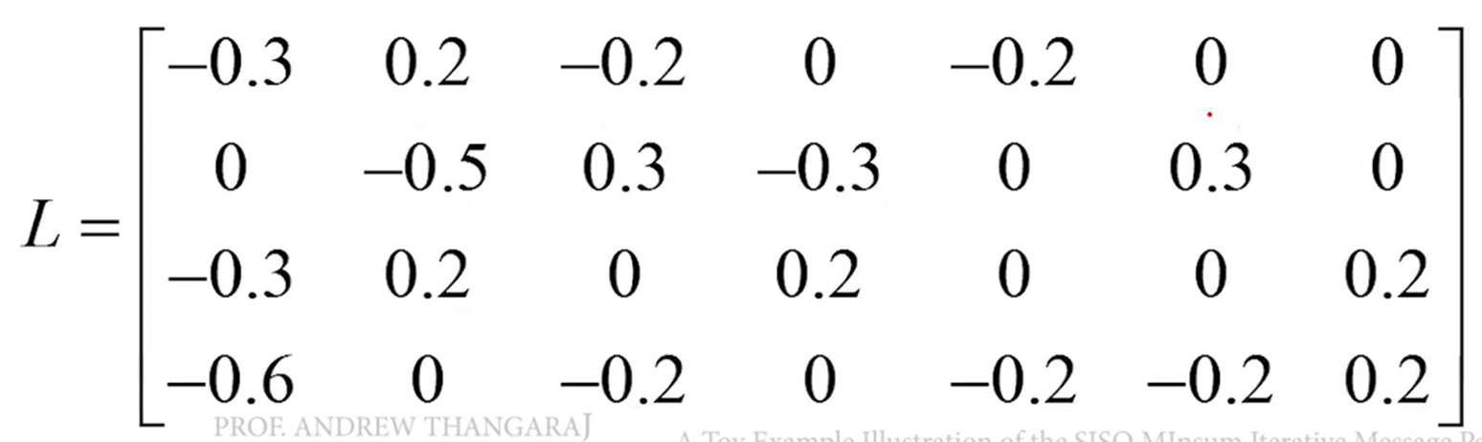
• Similarly performing the same steps on each row, we can finally obtain the following matrix :
Final matrix obtained after completion of ROW OPERATIONS.

Slide 38
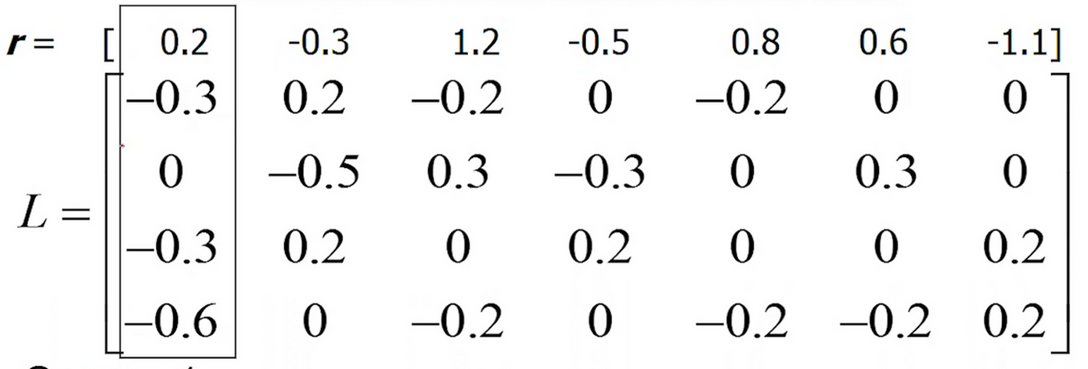
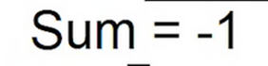
• Moving ahead with the COLUMN OPERATIONS : -
Here we are simply taking the sum of each element columnwise, including the corresponding element of received vector.

Slide 39
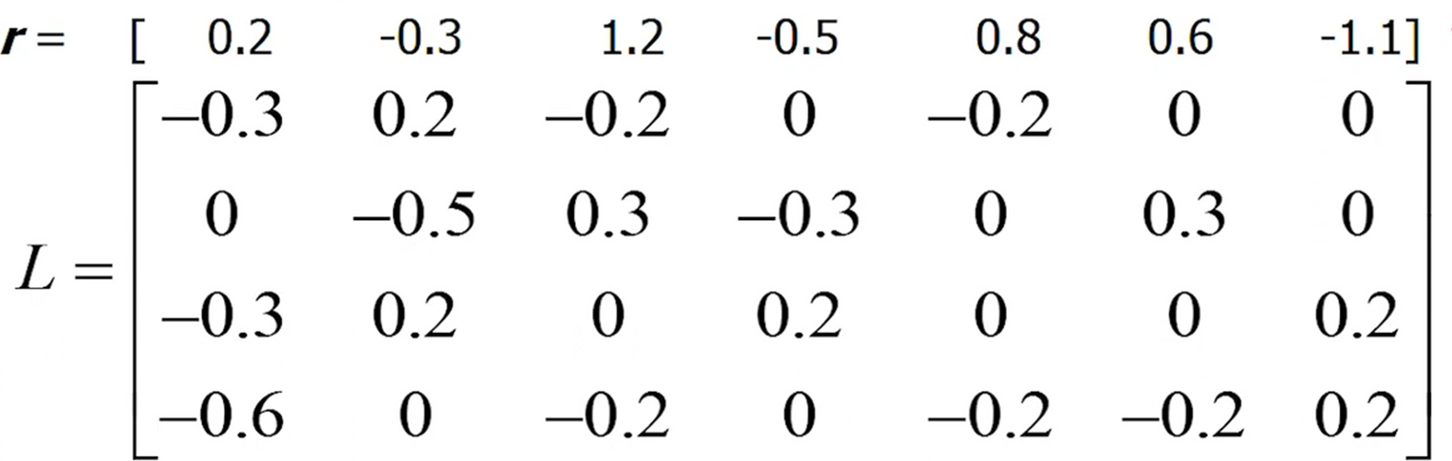
• These operations on each column results in the following matrix of sums :
After that, for each element, we are subtracting the value from the corresponding sum value columnwise.

Slide 40
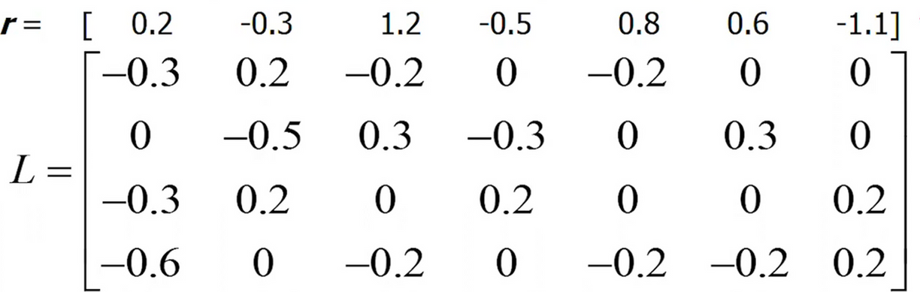

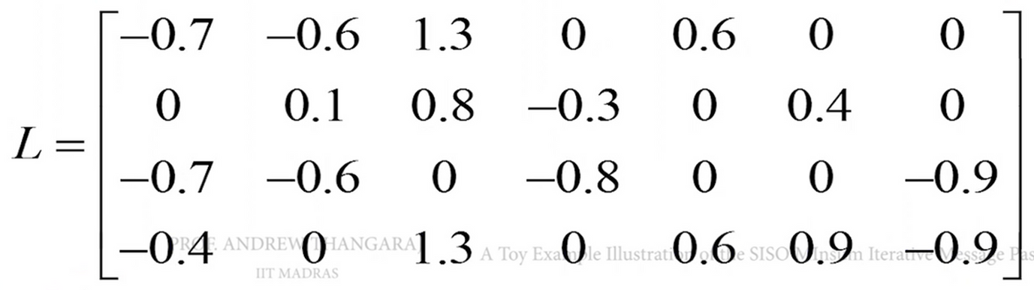
The Sum matrix is actually our estimated codeword of the provious iteration, which will be used for the following iteration.
The resultant of the COLUMN OPERATIONS is the following final storage matrix (L) :
This resulting L matrix is used as input for the next iteration and so on ...

Slide 41
Hard decision DEcoding

Slide 42
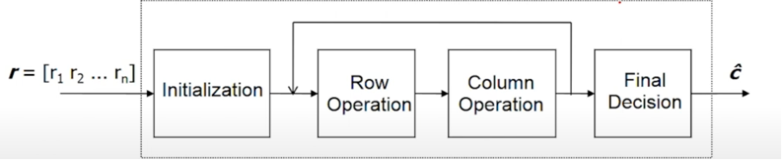
This is main concept for solving the hard decision decoding is by Tenner graph decoding. (Which we already learned in class)
Here as one can see, we will also receive some bits but these bits may have error so we are doing this hard decision decoding so that we can correct those errors.

Slide 43
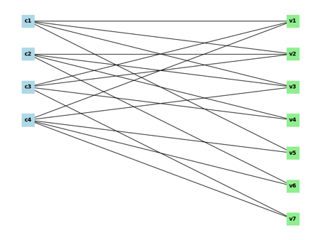
H matrix and Corresponding Tanner Graph
parity check matrix
H = [ 1, 1, 1, 0, 1, 0, 0;
0, 1, 1, 1, 0, 1, 0;
1, 1, 0, 1, 0, 0, 1;
1, 0, 1, 0, 1, 1, 1 ]
Storage Matrix
L = [ [x, x, x, 0, x, 0, 0],
[0, x, x, x, 0, x, 0],
[x, x, 0, x, 0, 0, x],
[x, 0, x, 0, x, x, x] ]
recived mesasage
r = [0.2 ,-0.3, 1.2, -0.5, 0.8, 0.6, -1.1]
Converted to hard bits r = [0 , 1 , 0 , 1 , 0 , 0 , 1 ]

Slide 44
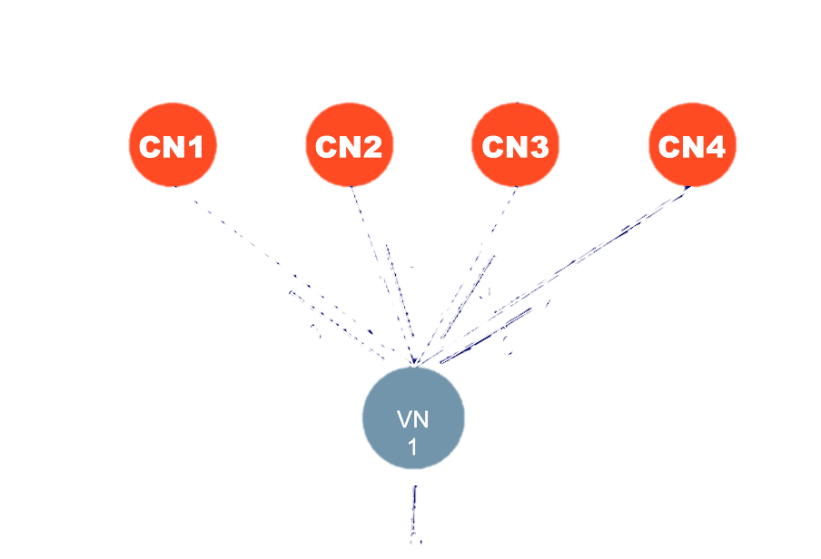
initialisation of CN’s
So in the initialisation step there is no value of CN’s present so VN’s will first pass message to CN’s with which they are connected and now CN’s will be storing the xor(^) of all the message that it received.

Slide 45
r = [0 , 1 , 0 , 1 , 0 , 0 , 1 ]
This is basically the L matrix (“-” indicates no connection)
we are substituting received bits into the storage matrix
CN’s will be having some values now which is xor of all connected VN’s to that CN
 | VN1 | VN2 | VN3 | VN4 | VN5 | VN6 | VN7
CN1 | 0 | 1 | 0 | - | 0 | - | -
CN2 | - | 1 | 0 | 1 | - | 0 | -
CN3 | 0 | 1 | - | 1 | - | - | 1
CN4 | 0 | - | 0 | - | 0 | 0 | 1

Slide 46
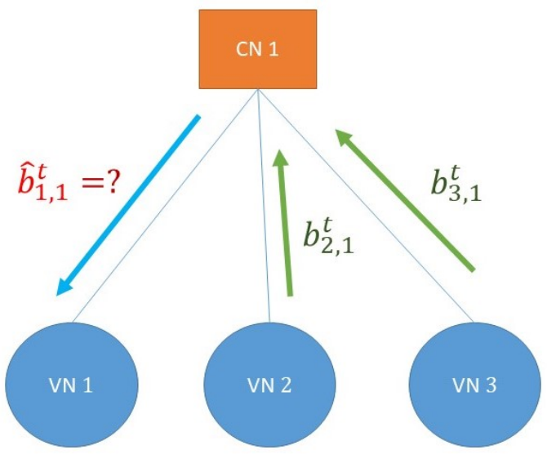
row operation’s or CN’s to VN’s message transfer
So to transfer the value to first VN from here we do xor of all the rest incoming values from the CN’s or simply the xor of current value of CN with what previos value was coming from that VN.
this we do for all the VN’s connected to it then we move to next CN.

Slide 47
Equivalent matrix operation
 | VN1 | VN2 | VN3 | VN4 | VN5 | VN6 | VN7
CN1 | 0 | 1 | 0 | - | 0 | - | -
CN2 | - | 1 | 0 | 1 | - | 0 | -
CN3 | 0 | 1 | - | 1 | - | - | 1
CN4 | 0 | - | 0 | - | 0 | 0 | 1
 | VN1 | VN2 | VN3 | VN4 | VN5 | VN6 | VN7
CN1 | 1 | 0 | 1 | - | 1 | - | -
CN2 | - | 1 | 0 | 1 | - | 0 | -
CN3 | 1 | 0 | - | 0 | - | - | 0
CN4 | 1 | - | 1 | - | 1 | 1 | 0
Iterate in every row and instead of the column in which it is present, take XOR of all the others in that row.
By single‐parity‐check (SPC), each CN sends to VN i the parity (XOR) of all other incoming bits

Slide 48
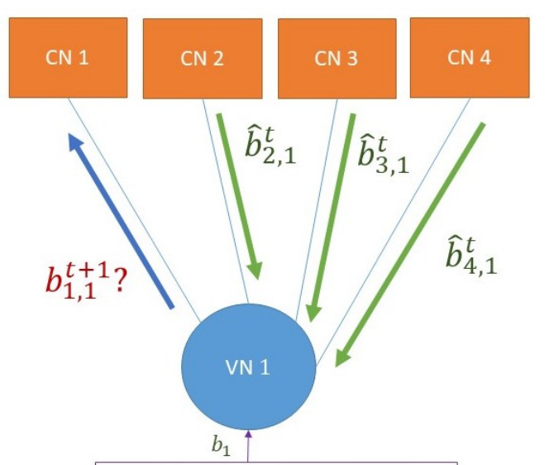
Column operation’s or VN’s to CN’s message transfer
So from VN’s to CN’s message transfer the repetition coding is used so to transfer the VN1 to CN2 we take the repetition coding from current value of VN and the value it received from other CN’s.
So we do this for all the CN’s connected to it and then move to the next VN until all the VN’s are finished.

Slide 49
Equivalent matrix operation
 | VN1 | VN2 | VN3 | VN4 | VN5 | VN6 | VN7
CN1 | 1 | 0 | 1 | - | 1 | - | -
CN2 | - | 1 | 0 | 1 | - | 0 | -
CN3 | 1 | 0 | - | 0 | - | - | 0
CN4 | 1 | - | 1 | - | 1 | 1 | 0
 | VN1 | VN2 | VN3 | VN4 | VN5 | VN6 | VN7
CN1 | 1 | 1 | 0 | - | 0 | - | -
CN2 | - | 0 | 1 | 0 | - | 0 | -
CN3 | 1 | 1 | - | 0 | - | - | 0
CN4 | 1 | - | 0 | - | 0 | 0 | 0
previous VN’s r = [0 , 1 , 0 , 1 , 0 , 0 , 1 ]
Each VN takes a majority vote over all CN→VN messages it receives
Here we have applied the logic that until no. of ones is strictly greater than the total non”-” numbers + 1(previous)/2 utill that we will put it 0 else 1 if condition satisfies.

Slide 50
When to break the loop
Previously we took some VN’s value that which we will store into some vector and this vector we will compare with the VN which we have now if the two value are the same then we can break the loop. (for Tanner Graph Approach)
Now, if VN is not the same as that vector update the vector with current value of the VN’s and we do the same two operation CN to VN transfer and the VN to CN transfer. (for Tanner Graph Approach)
Further, if all the CN’s become zero, we can break the loop in that case also.
Until the Syndrome vector doesn’t become zero we will continue the iteration or until we reach the maximum iteration limit. (for the matrix approach)

Slide 51
RESULTS

Slide 52
Results of NR_2_6_52

Slide 53
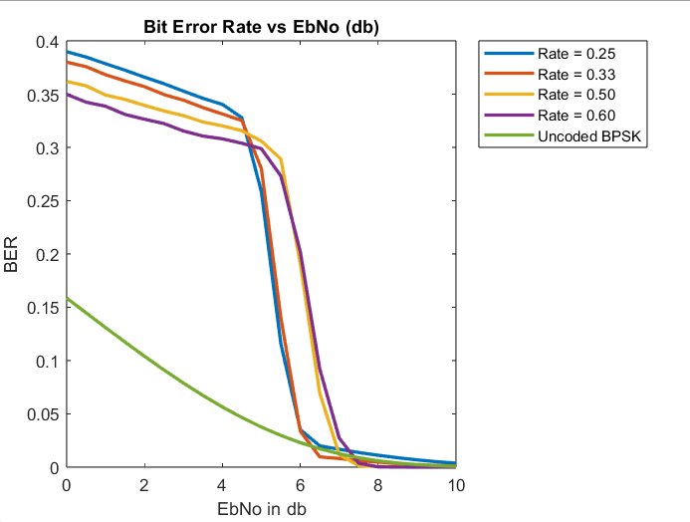
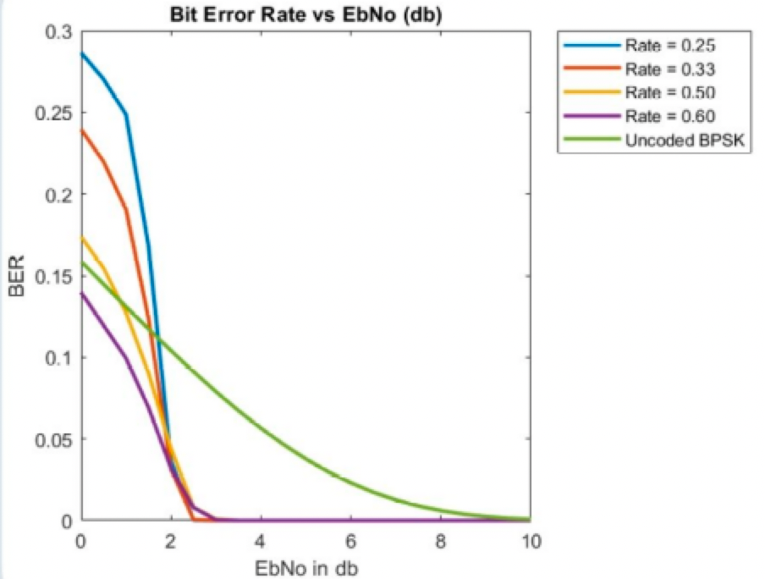
BER vs E_b/N_0
Hard Decision
Soft Decision

Slide 54
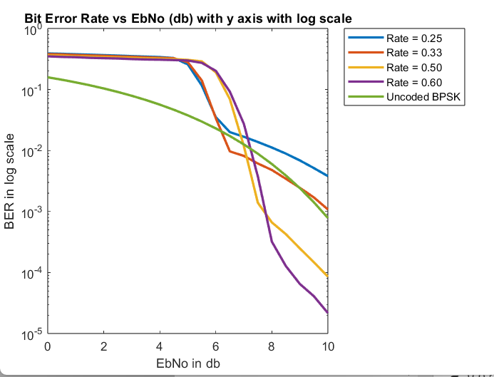
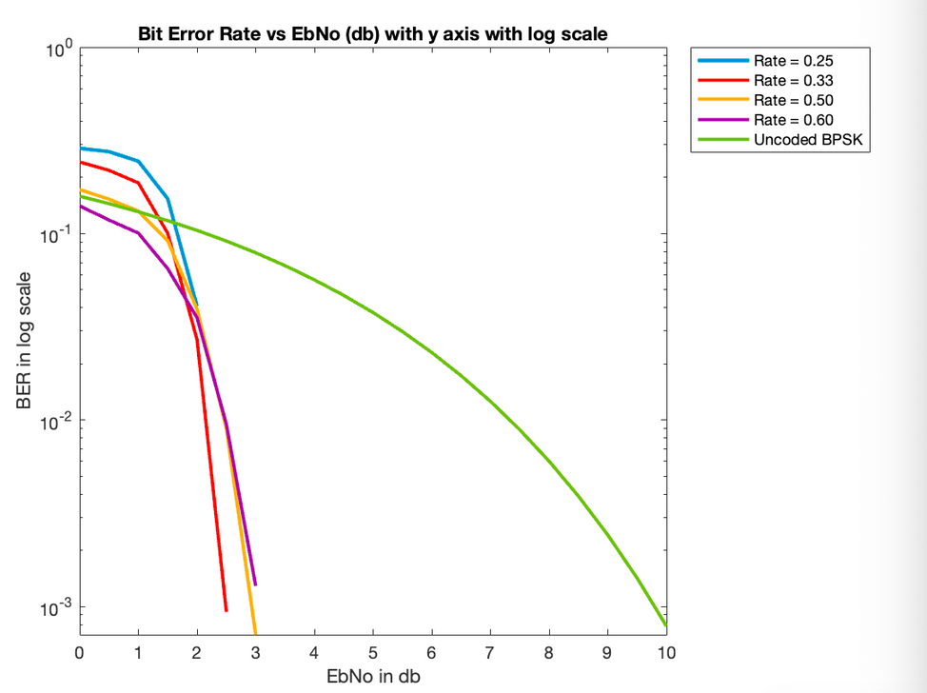
BER vs E_B/N_0(in DB) in Logarithmic Scale
Hard Decision
Soft Decision

Slide 55
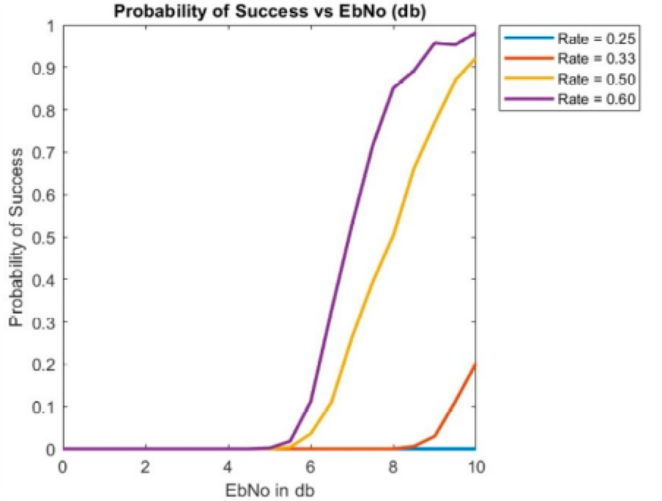
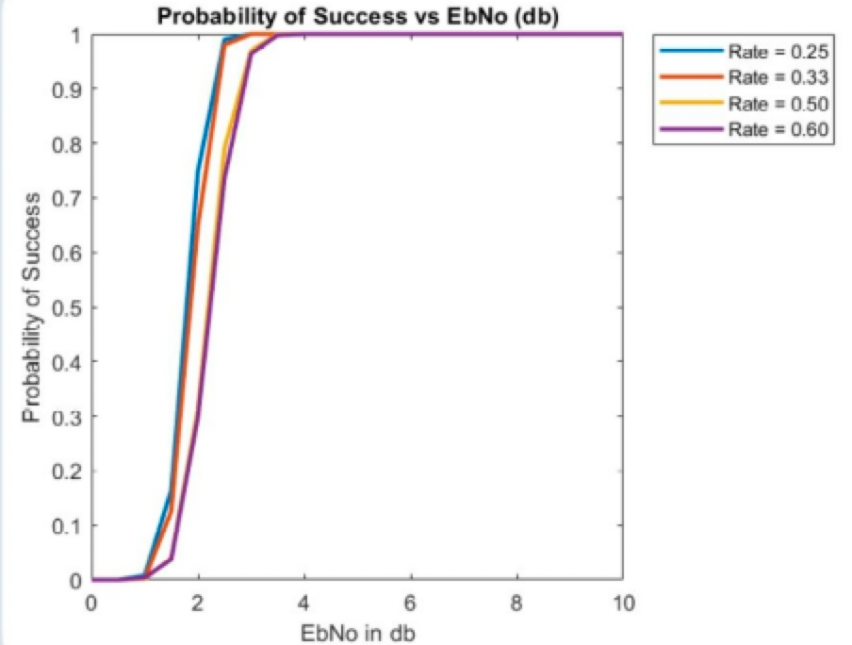
Probability of Success vs E_B/N_0(in DB)
Hard Decision
Soft Decision

Slide 56
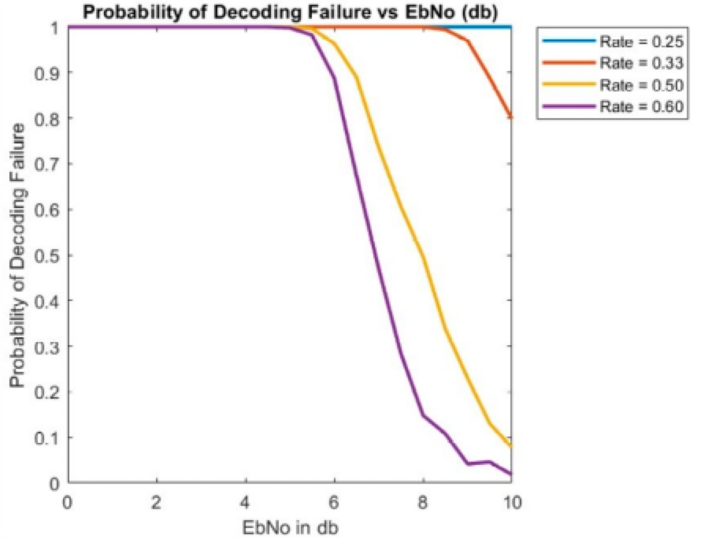
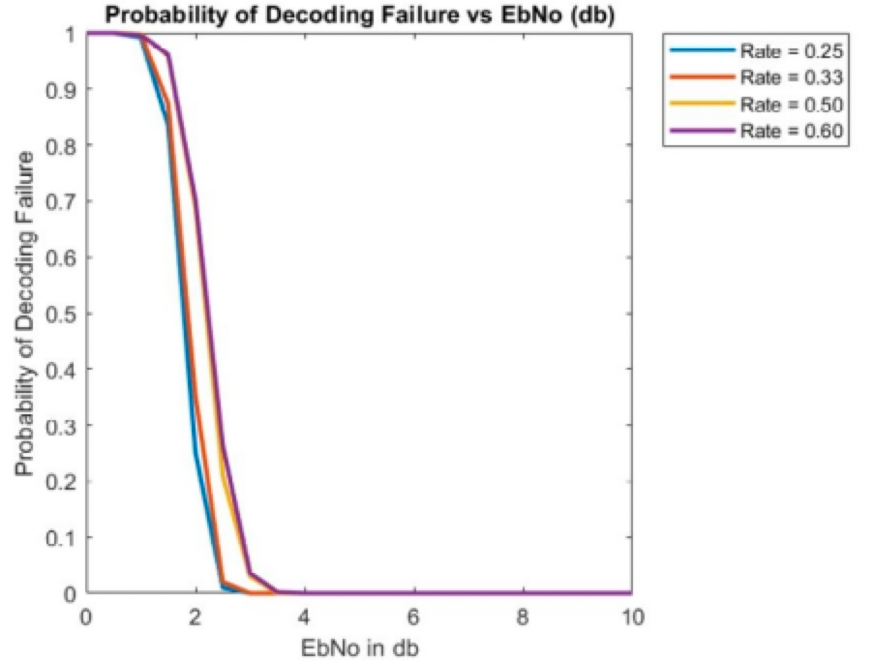
Probability of Error vs E_B/N_0(in DB)
Hard Decision
Soft Decision

Slide 57
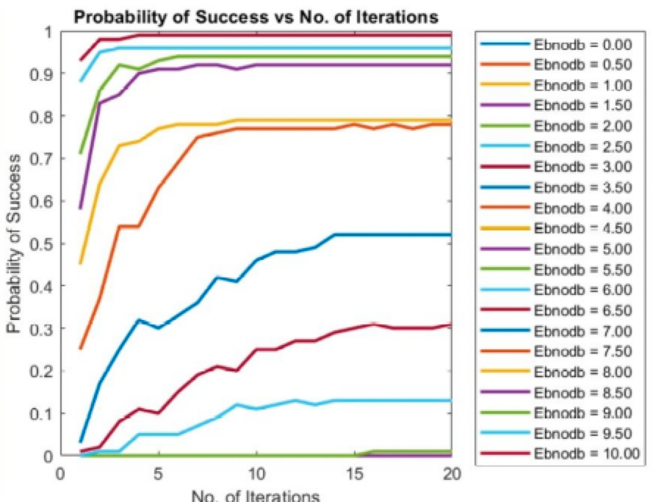
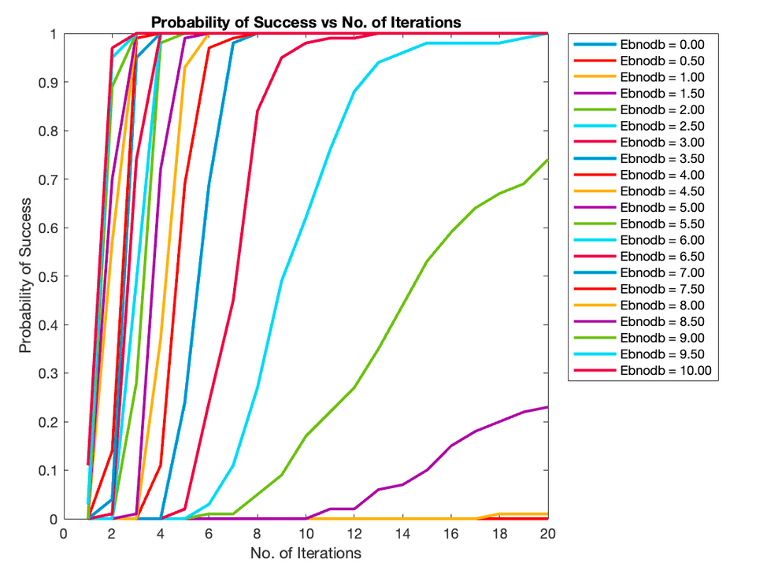
Probability of Sucess V/S No of Iteration
Hard Decision
Soft Decision

Slide 58
Results of NR_1_5_352

Slide 59
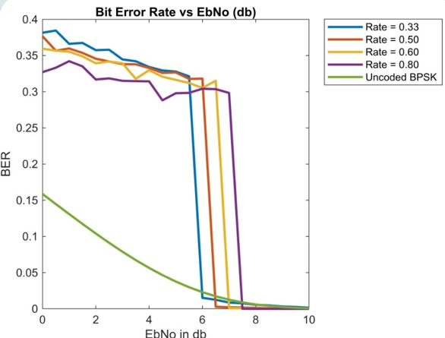
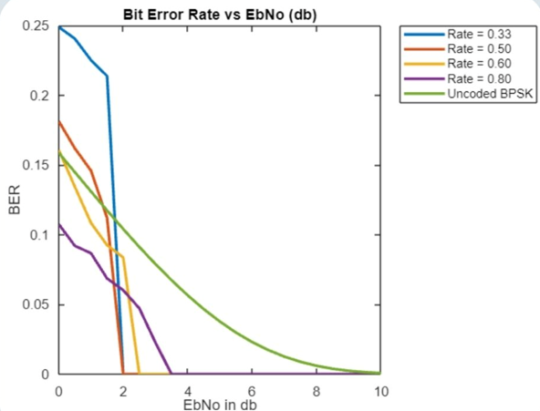
BER vs E_b/N_0
Hard Decision
Soft Decision

Slide 60
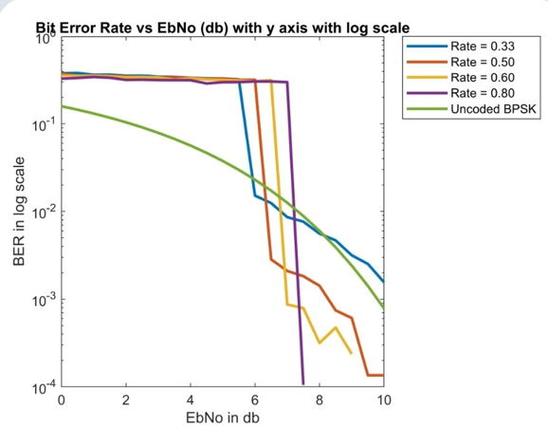
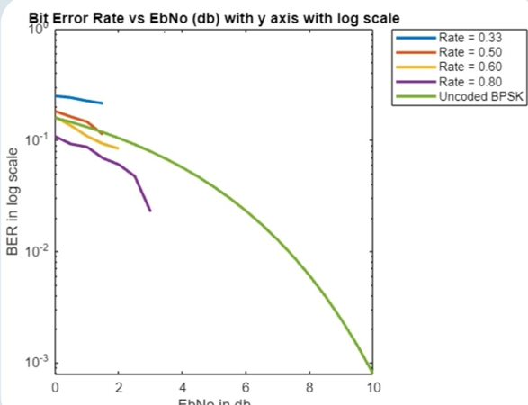
BER vs E_B/N_0(in DB) in Logarithmic Scale
Hard Decision
Soft Decision

Slide 61
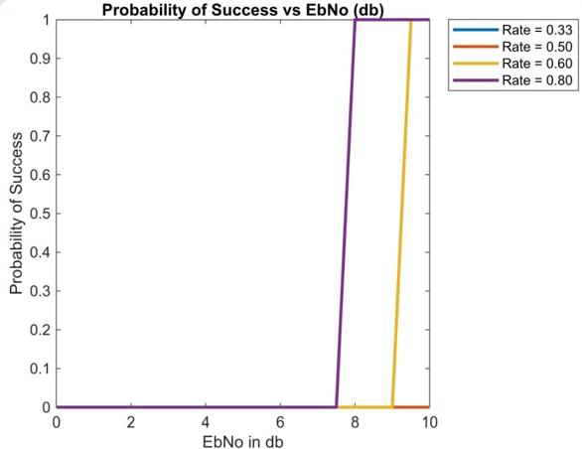

Probability of Success vs E_B/N_0(in DB)
Hard Decision
Soft Decision

Slide 62


Probability of Error vs E_B/N_0(in DB)
Hard Decision
Soft Decision

Slide 63
Comparison of the simulation with Shannon channel capacity bound
In the above graphs, we observe that the BER vs. Eb/No curve for Soft Decision Decoding achieves the same BER for a lower Eb/No value.
Soft decision decoding approaches the theoretical limit set by Shannon's capacity theorem more closely than Hard decision decoding does. This indicates that Soft decision decoding provides better performance in terms of error correction capability.

Slide 64
BIBLIOGRAPHY

Slide 65
REFERENCES
CT216. Introduction to Communication Systems: Lecture 3 Channel Coding.
DAIICT, Winter 2024.
R. Gallager. Low density parity check codes. IRE Trans. Information Theory, 1962.
Bernhard Leiner. LDPC codes – a brief tutorial. Self Study Project, 2005.
J. G. Proakis. Digital Communications. McGraw-Hill, 4th edition, 1995.
Implementation of Low-Density Parity-Check codes for
5G NR shared channels : LIFANG WANG.
Andrew Thangaraj. Ldpc and polar codes in the 5g standard, 2019. Accessed in April, 2025.
.

Slide 66
THANK YOU

